Slide 1
Bing AAIG Project Onboarding
Anna Emmett, Solution Architect

Slide 2

Our Client: Microsoft Advertising
Microsoft Search Network connects searchers on Bing, MSN, Yahoo, AOL and more sites powered by Bing
Used by 500k advertisers
13.9b monthly searches worldwide; 44.2m desktop searchers not reached on Google
37.5% of US desktop searches
2.69% of the global search market
Bing is run on more than 1.5b devices

Slide 3











Logic20/20 has a team working on the project
Project
Leadership
Logic20/20 Account
Leadership
Anna
Emmett
Adam
Cornille
AAIG Classifier Tool – Managed Service
AAIG Development Team
Analytics & Reporting
Eric Nelson
Nick Callahan
Jason Harenski
Divey Saini
Melvin Ong
Matt Trouville
Barry Weiss
Martavis Parker
Grant
Robertson

Slide 4
Useful links
Teams group
OneNote (also in each channel in the Teams group)
Repo

Slide 5



Project timeline
Model Box goes Live!
Initial new models:
Clustering
Basic Forecasting (incl. PPT slides)
Feb 2020
Maintenance & stabilization
Jan 2019 – May 2019
databricks integration in Prod
Dec 2020
Observatory Go Live
H1 2022?
Jul 2018 – Dec 2018
Initial Classifier implementation:
Only training Supervised ML models and applying them
Jun 2019
Current iteration start:
New Model Box UI – introducing custom models' upload
Jul 2020
COVID-informed Forecasting model released
Apr 2021
Beagle Go Live:
planned

Slide 6



How Model Box came to be: solving the handover problem
Data Scientists and Analytical Leads optimizing ad performance and revenue.
Model Creators
Data Scientists writing R & Python.
Want to build high-value, innovative models.
Model Users
Analytical Leads analyzing search activity data.
Want to automate and enhance their work.
We Want To Focus On Data Science
Serving models and results to our users requires us to be on-call for demands that take time away from innovation.
We Can’t Scale To Demand
Running models for many users, on big data requires infrastructure and operations time.
We Want To Focus On Insights
Accessing and applying models is time consuming, technically challenging, and breaks our workflow:
We need to install R/Python and dependencies locally.
We can’t run large analyses due to capacity constraints.
We don’t know which model version is current.
We Can’t Validate Models
We’re not data scientists. We depend on creators for up-to-date and accurate models.

Slide 7

















The Model Box enables scalability and fluid model deployment
Model Sharing Framework
Model Catalog
Browsable selection of deployed models with version tracking.
Experiment Library
Project-based organization of model runs with status tracking and results.
Data Repository
Storage of training data and data submitted for all model runs.
Auto-Scaling Infrastructure
Cloud based architecture that scales to serve many users and large data sets.
Model Templates
Minimal code templates allow any model type to be deployed via Kafka. Supports Python and R.
Easy Deployment Interface
Simple upload of model file triggers deployment to model catalog.
OOTB Classification Model Training
Users can train custom classification models with their own labeled data.
Friendly User Interface
Accessible web UI for creating projects, training models, running models, and fetching results.
Results Export
Downloadable Excel outputs with model results and accuracy documentation.

Slide 8
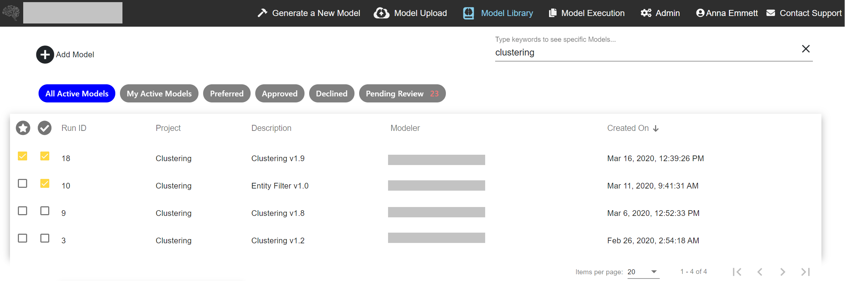
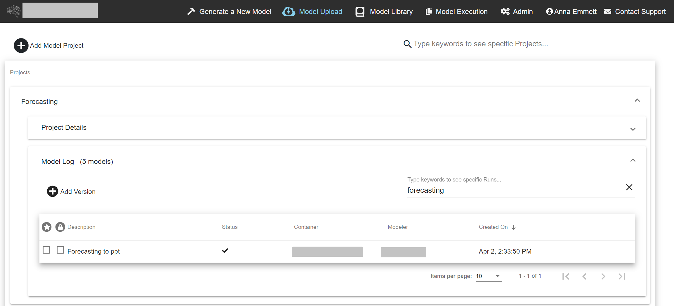
A light UI creates a seamless user experience
Model Creators
Model governance
Robust version control
Automated deployment into the existing back end
Model Users
Self-servicing UI
Immediate model availability
Result / inputs auditing
No need to set up own R/Python environments and dependencies
Collaborative process creates team efficiencies

Slide 9

Our process provides model governance and ease of use so teams can focus on what they do best
Release
Organize
Select
Deploy
Apply
supported
Review
Analyze
Create
Deliver
Model Creators
Design & build models with their favorite tools and libraries
Validate models as usual, with the option to track results in the sharing framework
Sharing Framework
Automate deployment
Execute models on scalable infrastructure
Organize models and projects
Manage model versions and dependencies
Track and store results
Model Users
Select curated models from the catalog
Receive self-service results quickly and dependably
Analyze and deliver results to stakeholders

Slide 10
Model Box: current Models
Model Description | Model Created By | Quarter
Clustering Light v1.0 | Logic20/20 | FY20 Q3
Clustering v1.0 | Logic20/20 | FY20 Q3
Forecasting Light v1.0 | Logic20/20 | FY20 Q3
Forecasting to CSV v1.1 | Logic20/20 | FY20 Q4
Forecasting to PPT v1.2 | Logic20/20 | FY20 Q4
Emerging Trends for Queries v1.0 | Logic20/20 | FY20 Q4
Rebound for CAT: Demand | Dragos Pribeagu | FY20 Q4
Rebound for CAT: Supply | Dragos Pribeagu | FY20 Q4
Paid & Organic - Job 1 of 2 | Sahar Manusevich | FY20 Q4
Paid & Organic - Job 2 of 2 w/ Token Template | Sahar Manusevich | FY20 Q4
Syndication Domain Affinity | Sahar Manusevich | FY20 Q4
Multi-Touch Attribution w/ Query Pathing | Sahar Manusevich | FY20 Q4
COVID Forecasting to PPT v1.0 | Logic20/20 | FY21 Q1
COVID Nowcasting to PPT v1.1 | Logic20/20 | FY21 Q1
Multi-Touch Attribution w/ CDJ | Sahar Manusevich | FY21 Q1
Token Clustering | Sahar Manusevich | FY21 Q1
Channel Feature Scenario Planner | Sahar Manusevich | FY21 Q1
Twitter Sentiment | Robin Hall | FY21 Q2
Paid & Organic - Job 1 of 2 (Account Level) | Sahar Manusevich | FY21 Q2
Paid & Organic - Job 2 of 2 w/ Token Template (Account Level) | Sahar Manusevich | FY21 Q2
COVID Sales Forecasting to PPT | Logic20/20 | FY21 Q2
FY20: 12
FY21 Q1: 5
FY21 Q2: 4
21

Slide 11

Model Box: databricks integration
Databricks connection released in December
Allows running databricks notebooks directly from Model Box UI
First interface to the backend data from the Model Box UI: anything accessible in databricks can be used, while keeping results available through the Model Box
Same end user experience for Model Users
Model Creators provide a databricks notebook link instead of an R or Python script
Single Model repository regardless of model source
Model execution statistics
Inputs and results sharing across peers
No additional dependencies installations in Model Box for databricks-based models
User tokens as part of input ensure that only authorized users can access databricks models. Other users cannot download the tokens from the UI: the tool scrubs them upon upload
MODEL BOX
1. Databricks models with data pull from a source
2. Databricks models with data pull and MB processing
3. Databricks models with user input / data pull and MB processing
4. Databricks models with user uploaded data

Slide 12





Future vision for the Model Box ecosystem
Completed: Databricks integration: allowing notebooks as custom models; connecting to data sources through databricks
To do: Automated scheduled search data classification using predefined taxonomies
To do: Sequenced automatic classification (e.g. 1. industry; 2. brand/non-brand)
To do: Custom model box run scheduling
To do: Automated generation of standardized content (e.g. slides with trends across months for specific client accounts): slide generation is already possible; automation depends on custom run scheduling
FY21 Q1-Q3: BEAGLE: Active
MODEL BOX
Discoverability of all content, including automatically generated, in the ML-powered tool
Functionalities include image-to-text & OCR (screenshot indexing) and synonym recognition
To do: Automated anomaly monitoring and alerting (anomaly detection model completed)
To do: Scheduled models’ curation pipeline
FY21 Q3-Q4: Observatory: in Design
Analyzing the search queries data pipeline to identify trends and inform analysis

Slide 13
MODEL APPLICATION EXAMPLES

Slide 14
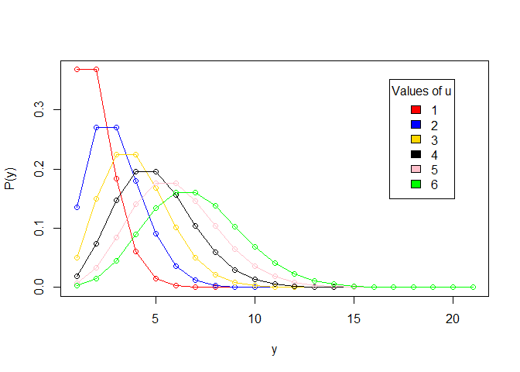
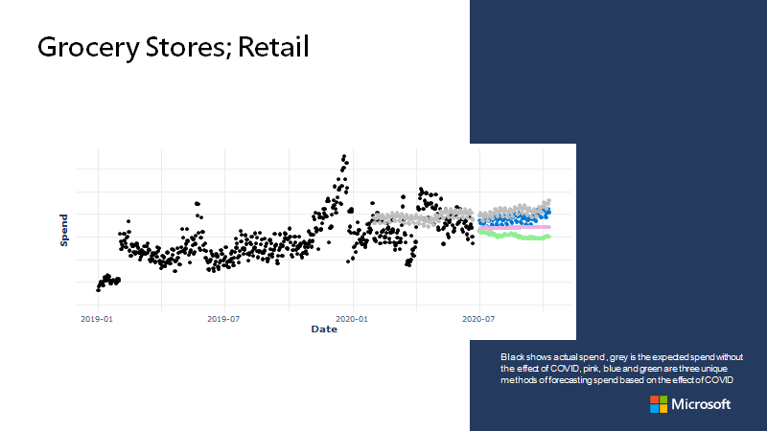
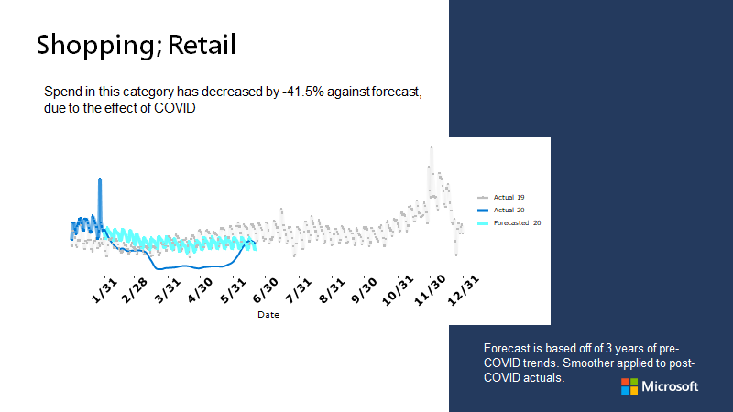
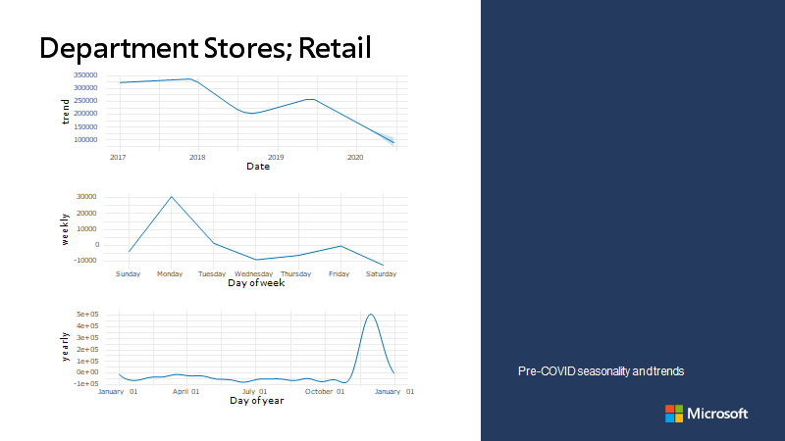
Business Needs
Model Box: COVID modeling: methodology
Method
Metric over 3.5 years
Fit, compare, select models
Make meaningful predictions about the market during COVID
Apply several models to achieve concordance
Create instantly useful graphics for presentation
Produce PowerPoint slides

Slide 15
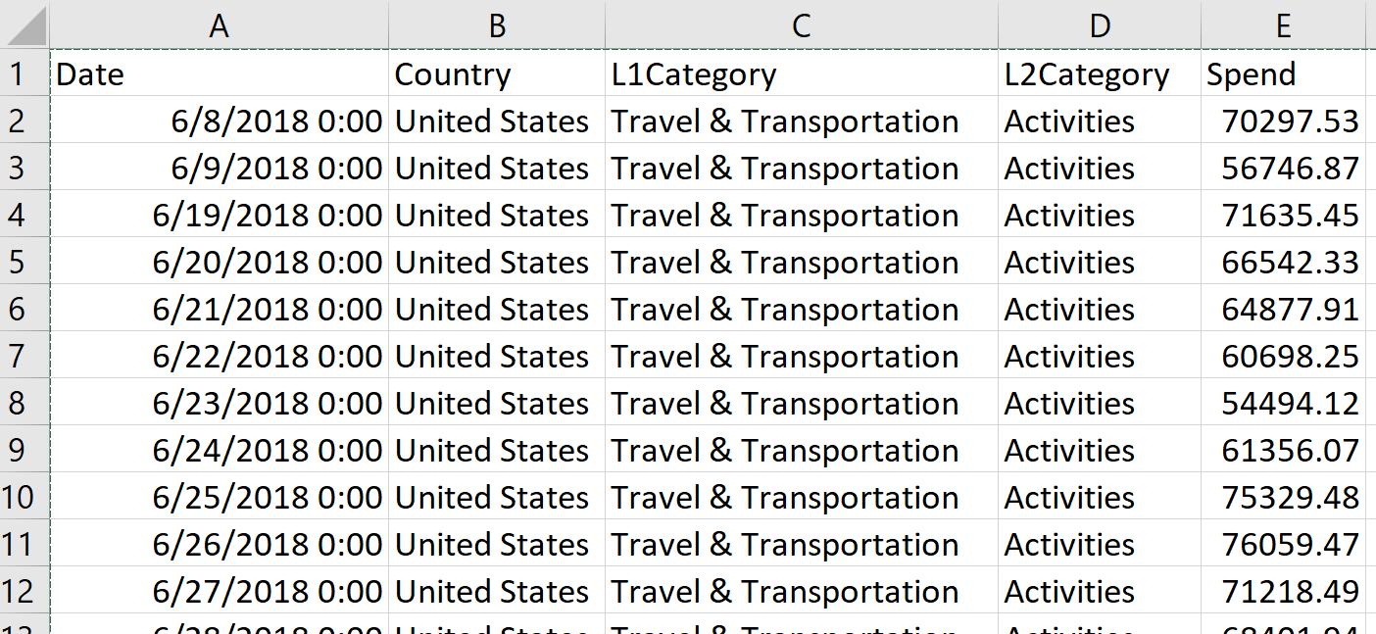
Inputs
Model Box: COVID modeling: components
Results
PowerPoint deck with Forecasts, Seasonality and Trends
Agora daily grain export

Slide 16
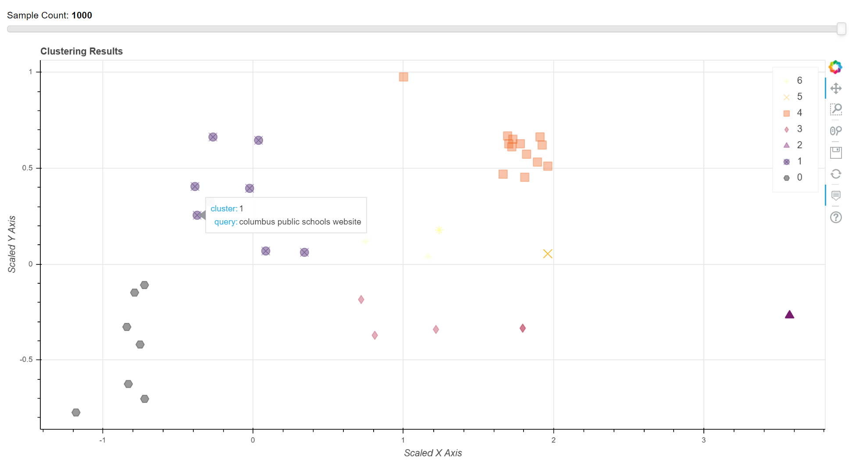
Custom Model: Clustering
Use Case: Clustering model can be applied to raw data to identify previously unexpected trends, outliers, or potential taxonomy items.
Sample Clustering outputs: html, csv
 | index | query | label
58 | 783 | public schools topsfield ma | 1
59 | 452 | nettleton school district mississippi | 1
60 | 507 | edmonton public schools ca | 1
61 | 55 | columbus public schools website | 1
62 | 624 | when expect federal tax refund nn2019 | 0
63 | 273 | phone number nys income tax | 0
64 | 686 | much fee filing taxes | 0
65 | 7 | dc first time tax abatement | 0
66 | 491 | are requirements file income tax return | 0

Slide 17
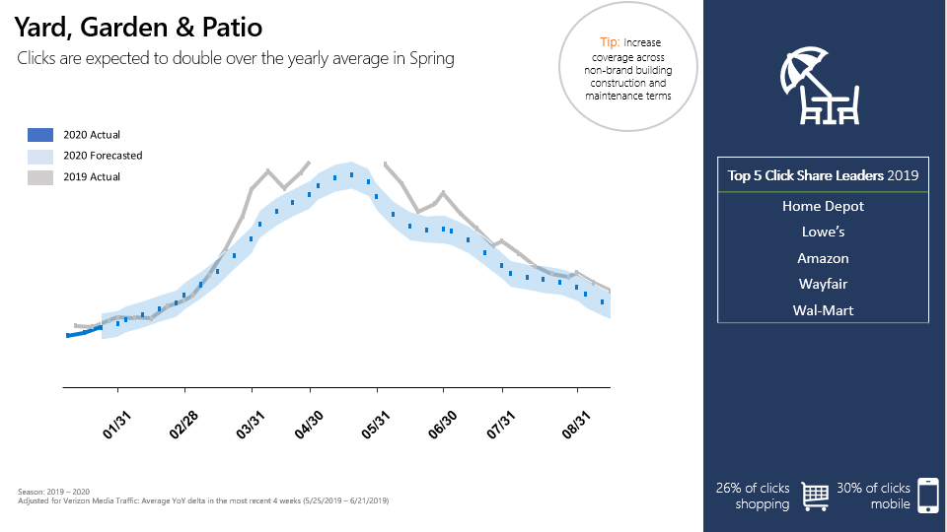
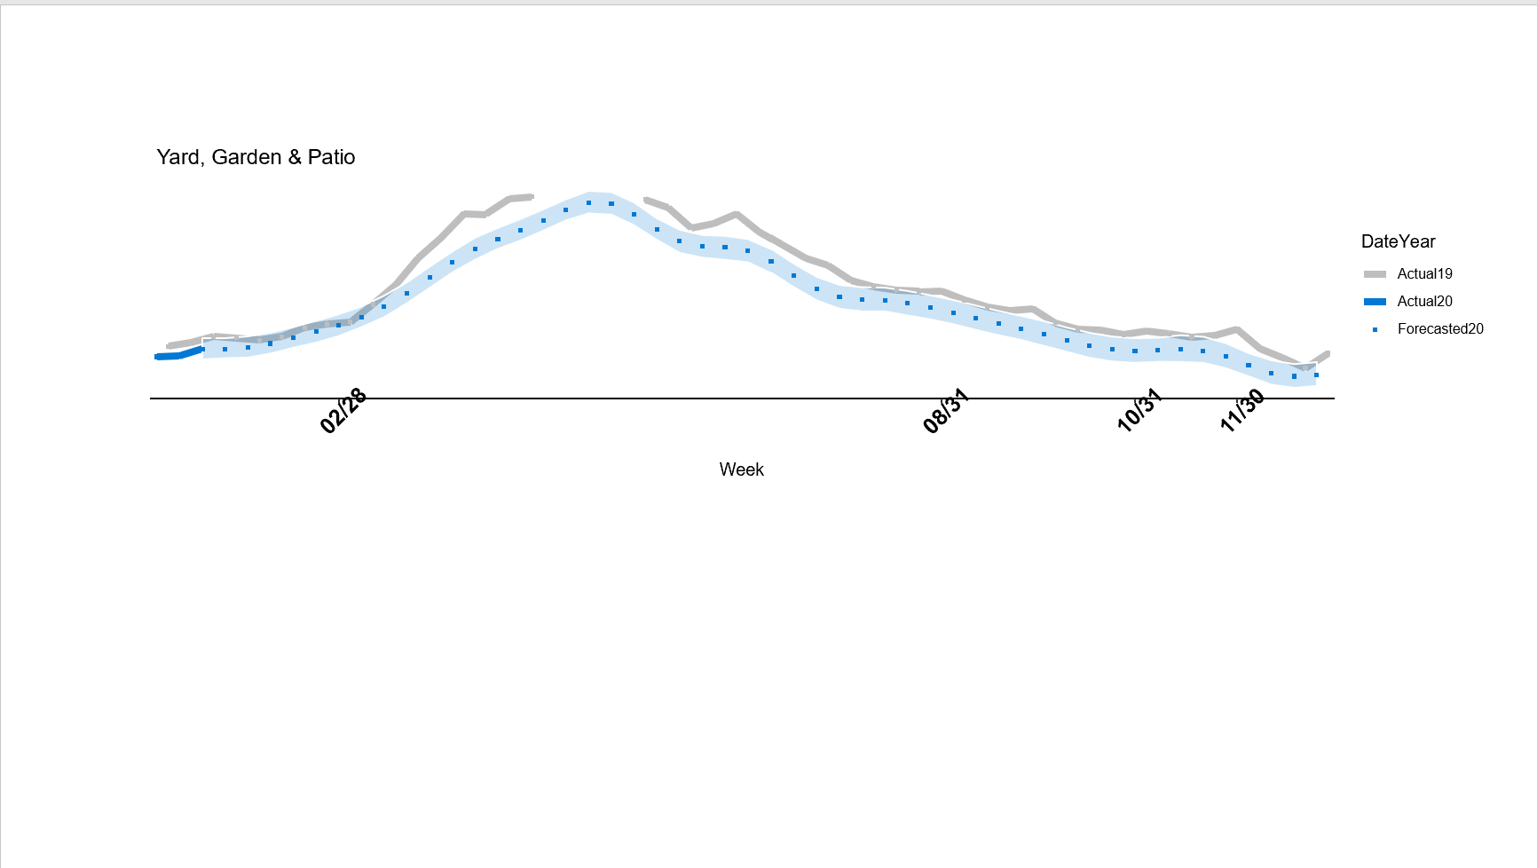
Custom Model: Forecasting
Use Case: Forecasting model can be applied to previously gathered historic data to calculate the trends.
Application example below: work done by the ASD team on Improvement Direct 3rd Party & Competitive trends with Retail
Sample Forecasting outputs: PowerPoint visual (right), applied in an ASD deliverable

Slide 18

BEAGLE

Slide 19










BEAGLE: Use Case overview
Problem statement: content (PowerPoint decks) is being created and refreshed at large scale to help Sales work with accounts in different verticals. Discovering individual nuggets of current and relevant information manually takes time and effort.
1
Multiple SharePoint sites contain PowerPoint decks with insights
2
Sites are scanned for changes in PPT content, decks are indexed into individual slides via text scraping, OCR
3
Users type the search phrase into Beagle and a selection of relevant slides is presented. The user can pick the slide(s) or deck(s) to download
4
The user downloads selected slides as a single PPT deck

Slide 20
BEAGLE: feature overview
Traditional SharePoint search for PowerPoint decks
Full file returned: the user needs to manually look through the slides in the file to find the relevant ones: if multiple files appear relevant the process will have to be repeated
Search across a single SharePoint location
Search by PowerPoint file content – text only
OCR is available for files that are images stored in a SharePoint location but not for images that are part of a slide deck
Beagle MVP
Individual slide search while preserving the deck context
Tree-shaped results: ability to download the whole deck or a subset of slides
Collating selected slides into a single deck for downloading
Search across multiple SharePoint locations
Search by slide text and text identified using OCR
Ability to report wrong results for removal from index
Beagle future features (post-MVP):
Slide thumbnail preview within the tool
Synonym search (e.g. “car” if the search is for “auto”)
MS Teams bot UI
Combining results of multiple queries into a single deck
Predictive search input
Ability to incorporate Beagle search bar into other sites
Ability to report wrong results for manual admin review

Slide 21
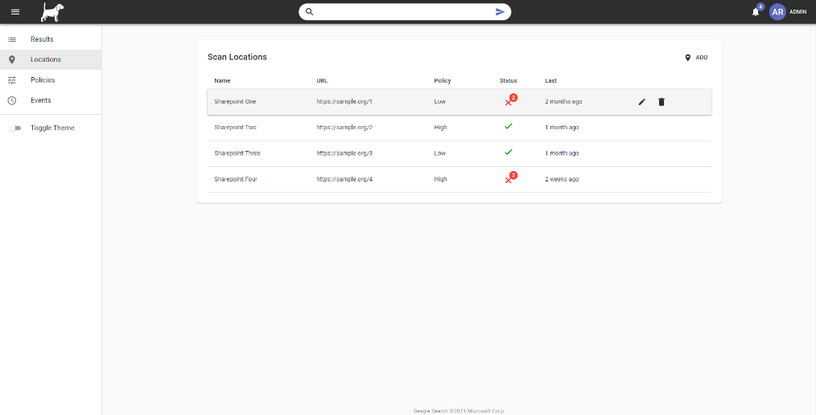
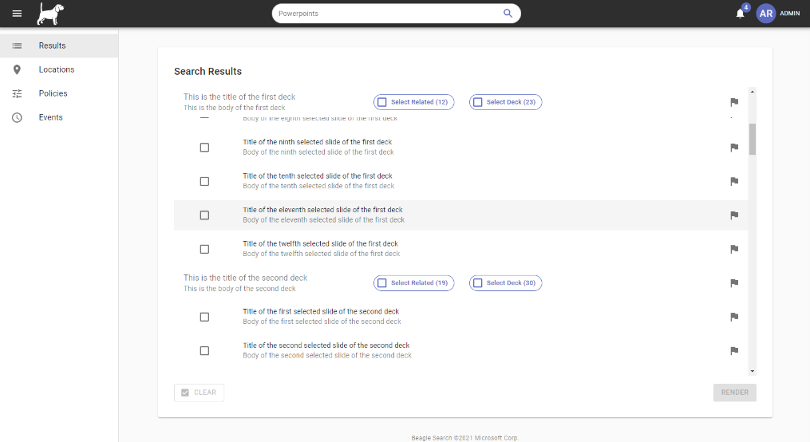
Beagle: current UI

Slide 22
Observatory

Slide 23
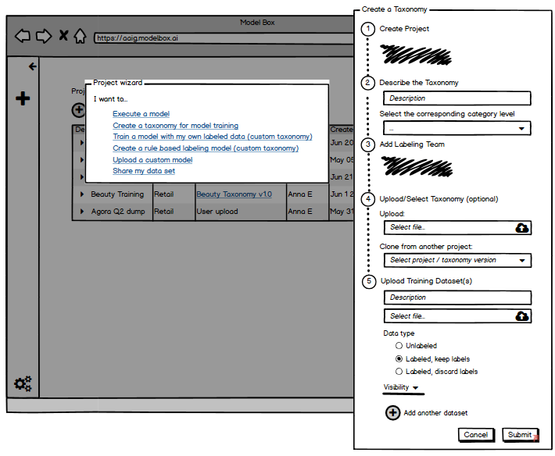
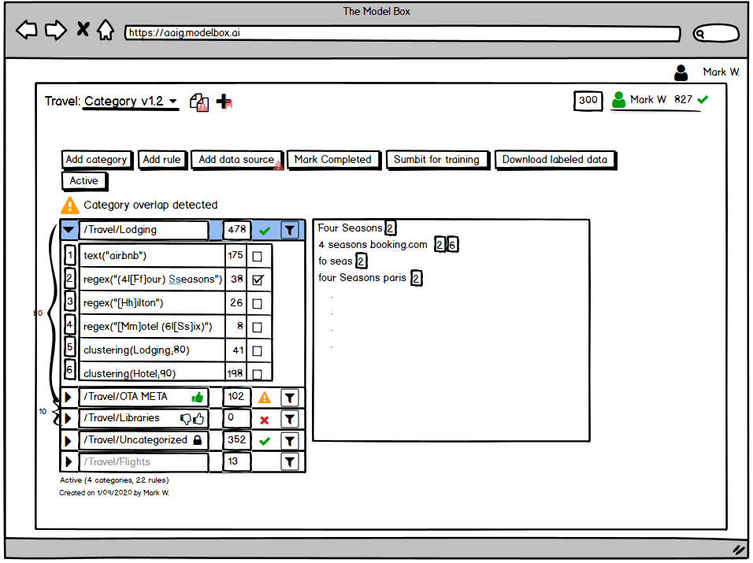
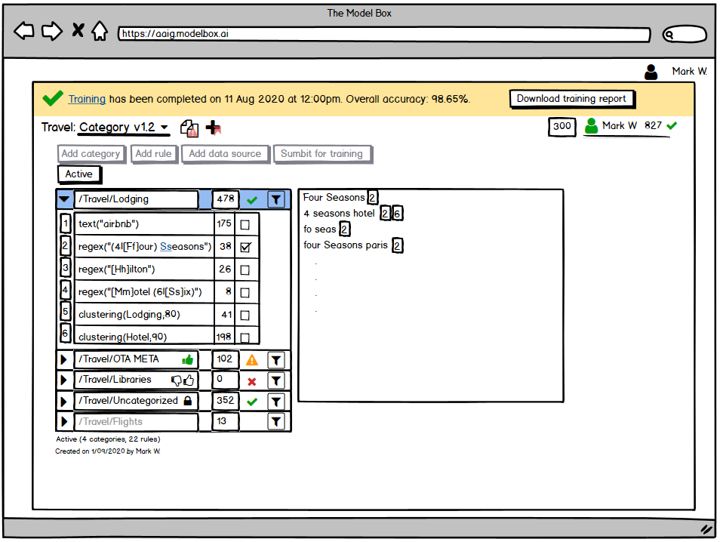
Taxonomy Editor: original concepts
Original Use Cases:
Allow rapid creation of key-value pairs supporting the Supervised Machine Learning training to create a classification model (using regex, clustering, and string matching)
Allow creation of custom models using regex rules
Concerns identified during the initial design phase:
Attempts to create mutually exclusive taxonomy categories lead to potential “coin toss” situations when multiple categories fit equally
A query cannot be assigned multiple categories
Model accuracy relies heavily on the sampling given in key-value pairs that might not accurately represent the larger pipeline
Lack of visibility into potential category overlaps
Focus on data preparation vs data analysis

Slide 24
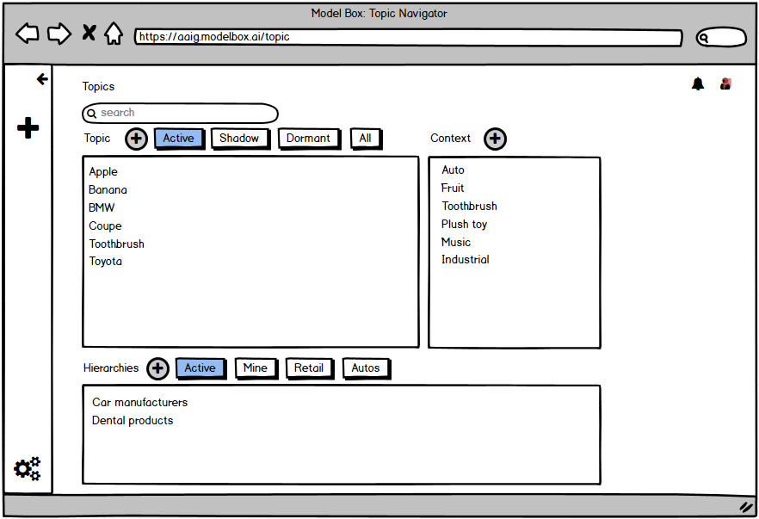
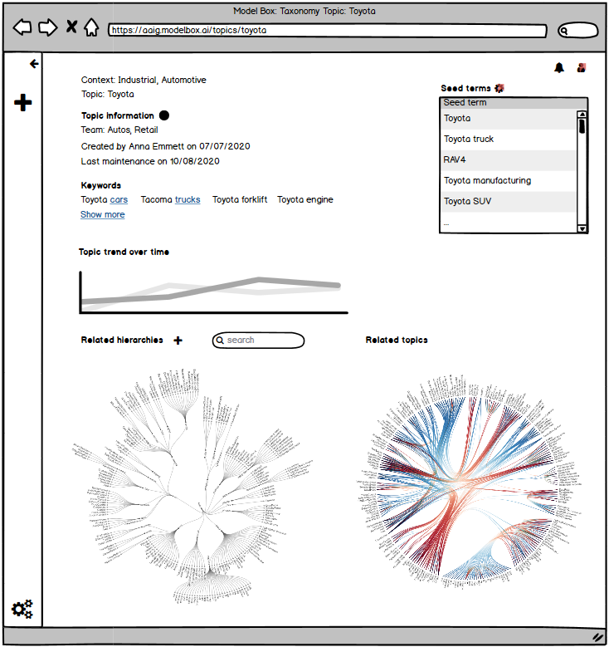
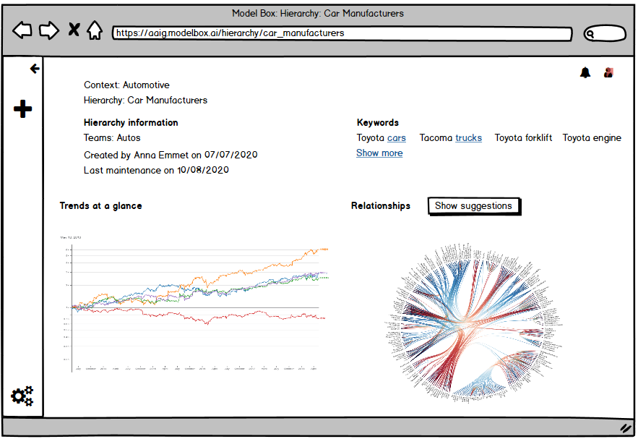
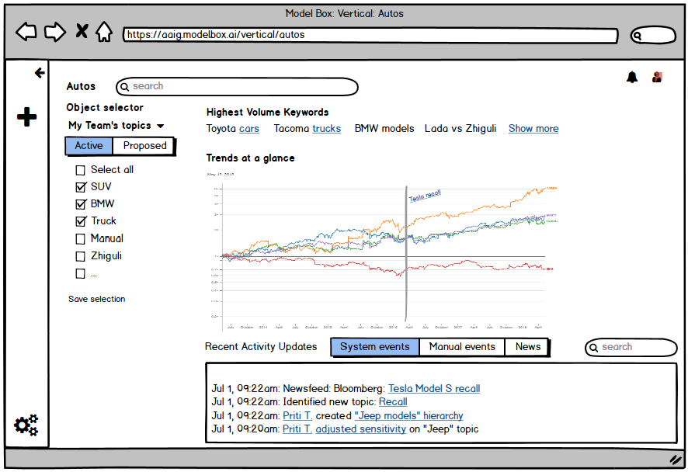
Observatory: exploratory concepts
Revised Use Cases:
Allow categorizing queries from multiple topic association point of view (holographic affinity map): every category in every taxonomy in the tool becomes a topic
Allow pulling statistics and trends from custom manually imposed topics structures (“hierarchies”)
Approach benefits:
Shift from labeling to exploratory work
Seeding vs distinct query collection
No conflicts of categories or necessity to pick one when multiple are available
Representation of the whole data pipeline
Automated topic suggestions
Concerns identified during the initial design phase:
Paradigm shift from manual data labeling and training

Slide 25
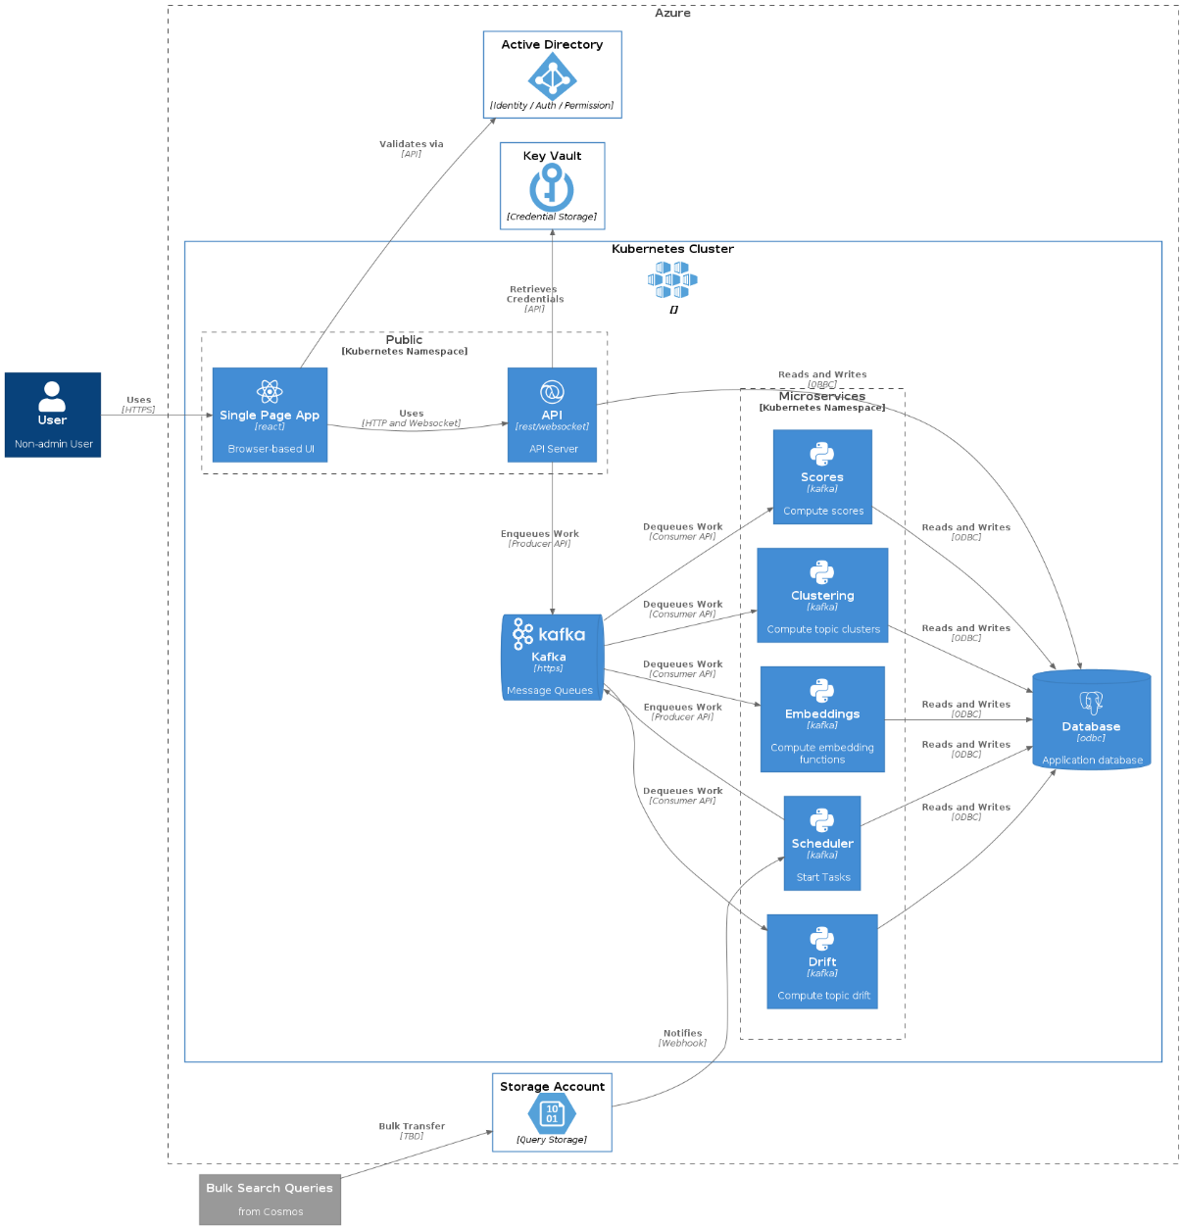
Observatory: design status
Design, onboarding, evangelization
Continued detalization of the UI mock-ups
Kicked off the focus group with the end users to validate the initial designs and collect feedback
Started a list of edge cases to be tested during the Proof-of-Concept Data Science exercises
Started aligning on a common vision on the Marketplace Rotation visualizations (Kevin K.)
Working on identifying potential synergy with the ICE improvements workstream (Dragos P.)
Continuing to define the long-term vision, including potential external interface
Defined the High-Level Architecture (right)

Slide 26
Observatory: UI mock-ups
Notes:
Revised Use Cases:
Allow categorizing queries from multiple topic association point of view (holographic affinity map): every category in every taxonomy in the tool becomes a topic
Allow pulling statistics and trends from custom manually imposed topics structures (“hierarchies”)
Approach benefits:
Shift from labeling to exploratory work
Seeding vs distinct query collection
No conflicts of categories or necessity to pick one when multiple are available
Representation of the whole data pipeline
Automated topic suggestions
Concerns identified during the initial design phase:
Paradigm shift from manual data labeling and training

Slide 27
Observatory Pipeline overview
Tagging incoming search query data with relevant topics
Luxury
Wagon
Audi
Gasoline
Mercedes
Car Makers Hierarchy
2015 Audi all road
2015 Audi all road
Audi
2017 Mercedes GLC
2017 Mercedes GLC
SUV
Economy
2015 Audi all road
Rogue vs CRV
cheap flights
Rogue vs CRV
cheap flights
Nissan
Best hotels Rio
Best hotels Rio
Mercedes
Rent-a-car
Honda
2017 Mercedes GLC
Rent-a-car
Medicare 2020
best bagels
Medicare 2020
Nissan
best bagels
magnetic lashes
Covid-19
magnetic lashes
Covid-19
Rogue vs CRV
is Superbowl cancelled
is Superbowl cancelled
Honda
new iPhone
new iPhone
Rogue vs CRV
…
…
Moskvitch
1
2
Each incoming query is tagged by all the relevant topics (binary determination of relevance for each topic based on a query falling into the topic cluster definition based on its seed words and assigned clustering distance from the seed words)
3
Users create hierarchies of topics to perform reproducible analyses; each hierarchy a collection of topics and associated trends
Bing Search query pipeline – receiving new queries

Slide 28




Observatory Emerging Trends Detection Pipeline
Identifying new emerging concepts, suggesting them for review / inclusion; monitoring existing topics’ health
Existing Topics
COVID-19
Queries by date
Top N queries
COVID-19
COVID-19
Audi
PSL
Merging into existing topic
Fires
Emerging Clusters
PSL
Fall Drinks
Model
Audi
Fires
PSL
Supreme
Court
New Topic
Declined Topic
Supreme
Court
Supreme
Court
Fires
1
2
Model identifies conceptual clusters of potential interest
3
Application identifies clusters that already exist as topics and net new clusters and their L1 affiliation
4
Emerging Trends Detection Model gets applied to a sampling of top queries on a schedule
The user receives and reviews new cluster suggestions (declining, merging into existing topics, creating new topics)

